Slide 1
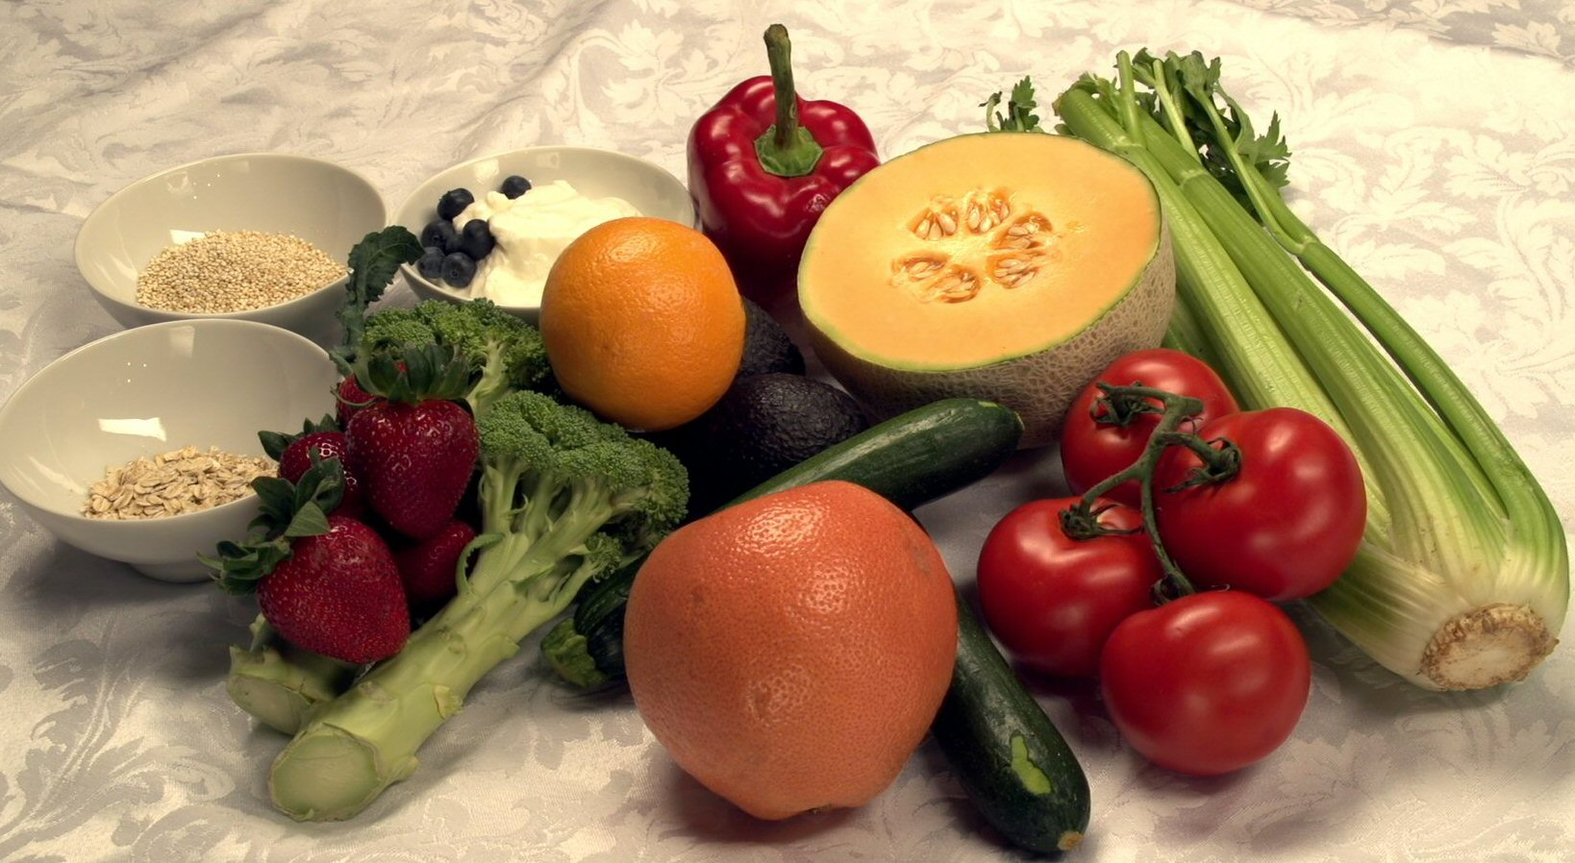



Foods to Reduce Stress
Improving Your Metabolism
Getting Through the Day
with Energy to Spare
chefmarshallobrien.com

Slide 2

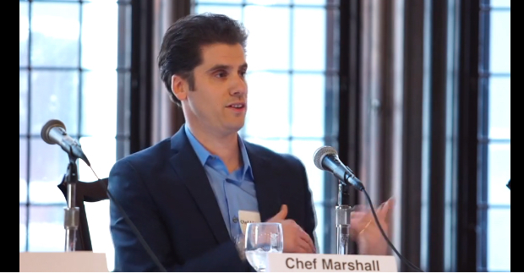
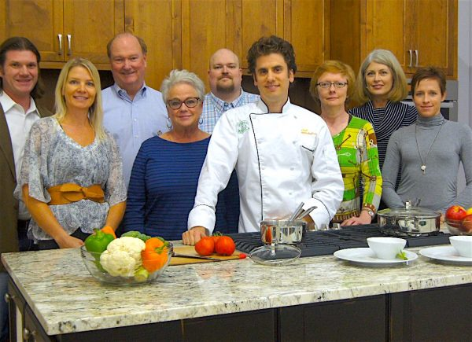
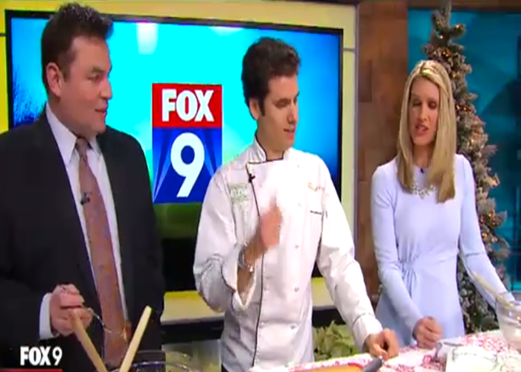
About the Chef Marshall O’Brien Group
About the Chef Marshall O’Brien Group
Notes:
CMO Group mission is to help kids and families lead happier healthier lives using Smart Nutrition.
CMO Group is a collective of:
· RDs and researchers
· Chefs – Put Delicious in Nutritious
· Writers, videographers and an Editor Publisher
CMO Group works with:
· 5000 child care providers in MN, Utah, and Nebraska
· Reach almost 200 school districts in MN, Utah
· Work with Cities – Fire, Police, Public Works – teaching nutritional strategies to be safer on the job, more pain free
· twincities YMCA as their nutritional partner
· Companies/Corporations– teaching nutritional strategies to improve quality of life

Slide 3

Changing the Health Paradigm
As a Wellness Champion, you have more influence than you may realize.
Notes:
As a Wellness Champion, you have more influence than you may realize.
How often do you get a chance to make a truly life changing effect on your friends, your family and yourself?

Slide 4

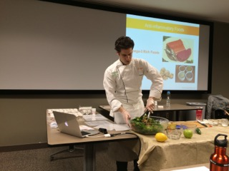
Smart Nutrition Support
Classes Smart Nutrition
Workbook
Notes:
I’m here to be a resource for you -
We can help you and your peers learn what to do to be proactive with your nutrition through our classes and workbooks.

Slide 5
Smart Nutrition Support
6 components to Smart Nutrition classes
1 hour presentation
Topic articles
Cooking demonstration
Recipes to take home
Food samples
Action Plan to get started
All first time attendees receive Smart Nutrition workbook
Notes:
We provide 5 things in our classes –
1.) 1 hour presentation on a selected topic (Reduce Stress, etc) and Workbook discussion
2.) Specific articles on topic,
3.) Do a cooking demo – show how easy it can be
4.) Provide recipes related to topic
5.) Sample recipes – experience how great food can taste
6.) Action plan – help get started taking action
PASS OUT FOOD SAMPLE – BRIEF TALK ABOUT WHAT THEY’RE EATING – TASTE GREAT & HEALTH BENEFITS – (GIVE THEM MINI EXPERIENCE OF A CLASS)

Slide 6
Changing the Health Paradigm
You are the Champions
Notes:
You are our champions and your messages will truly be a life changer for your friends, your family and especially yourself.

Slide 7
You Will Love the Way You Feel!
Thank you!
Follow us :
info@chefmarshallobrien.com
chefmarshallobrien.com

